Slide 1
Becker
Legislative Update and Roadmap
June 23, 2022

Slide 2
Background
CEPD retained Becker on November 1, 2021.
Preparation for 2022 Legislative Session was already underway.
Interim Committee weeks began in September.
Legislative Session convened on January 11, 2022.
Many bills were already moving through the process at that point.

Slide 3
CEPD Priorities
The CEPD - Becker agreement identified two initial priorities.
The most critical was amending state statutes to allow independent districts, like CEPD, to apply directly for the Resilient Florida programs.
Despite having been retained late in the legislative calendar, the Becker Team quickly went to work to address this issue.
After countless meetings, phone calls, emails, and text messages with legislative leaders and staff, language was worked out to allow erosion control districts to access these funds directly.
As you recall, previous attempts to work through Lee County were unsuccessful.
Without this change, CEPD would likely never gain meaningful access to millions of dollars in project grants.

Slide 4
Getting Access to the Resilient Florida Program Matters
“By September 1, 2021, and each September 1 thereafter, the following entities may submit to the Department a list of any proposed projects that mitigate the risks of flooding or sea level rise on water supplies or water resources of the state, and a corresponding evaluation of each project:”
  Water management districts
  Drainage districts
  Erosion control districts
“The total amount of funding proposed for each year of the plan may not be less than $100 million.”
“Multiyear projects that receive funding for the first year of the project must be included in subsequent plans and funded until the project is complete.”

Slide 5
New Projects
The CEPD-Becker agreement also identified providing support for updating and modernizing CEPD organizational documents or legislatively-created mission/role.
  Local bill process begins this Summer.
2022-2023 Local Support Grant is available now.
  Infrastructure improvement? Bridge or road repair? Utility upgrade? Environmental issue?
Resilient Florida Grant access
  Work with CEPD consultants and DEP staff where necessary to prepare organized approach for grants.
2023 Legislative Session issues
  Prep for 2023 starts today
  Legislative appropriations
  More changes to state law

Slide 6
Discussion
It is simple, the Becker Team delivers.
What is next?

Slide 7
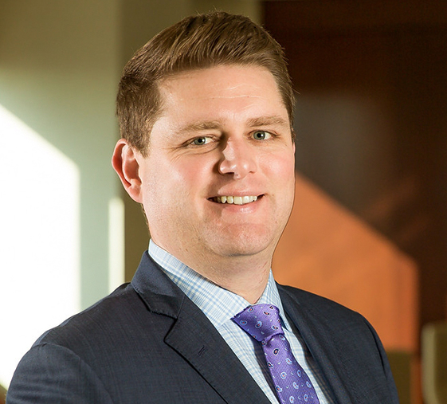
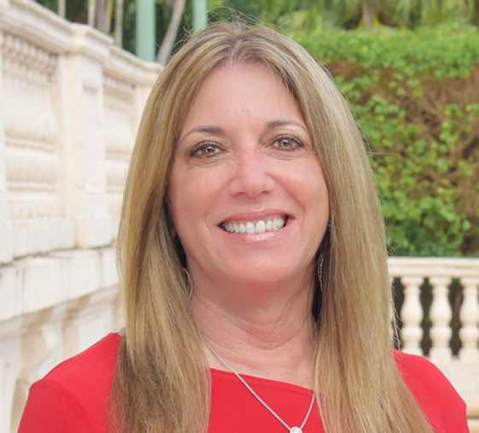
Your Becker Team
Nicholas G. Matthews
nmatthews@beckerlawyers.com
954.985.4135
Ellyn S. Bogdanoff
ebogdanoff@beckerlawyers.com
954.364.6005

