Slide 1
RESILIENCE, ADAPTATION & RECOVERY STRATEGY & IMPLEMENTATION
CAPTIVA EROSION PREVENTION DISTRICT
APRIL 2022

Slide 2
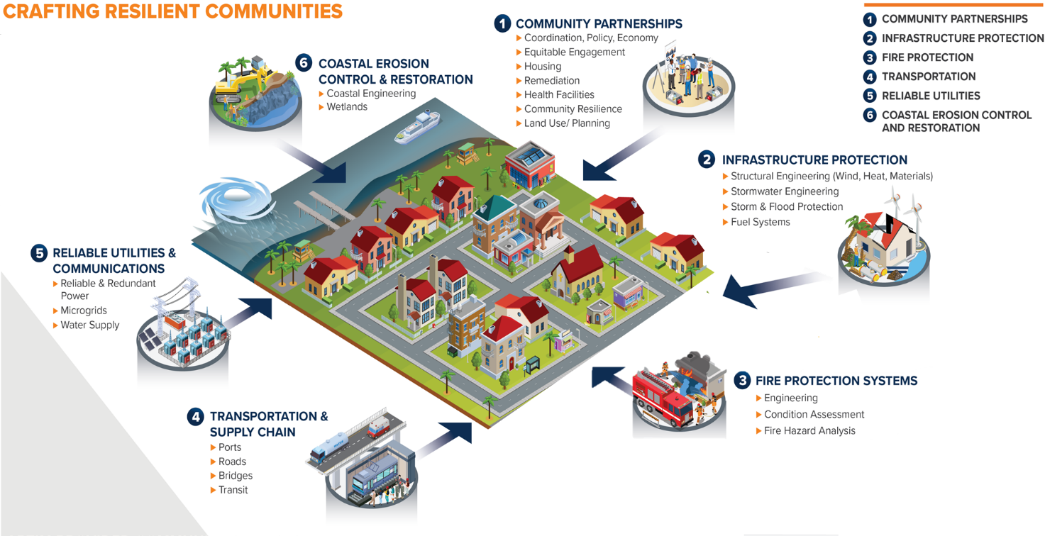
Address sea level rise mitigate risk through adaptation
Tidal flooding
226 days of tidal flooding by 2060 without adaptation
$483,000 loss annually
National Risk Index
Tipping point between 2 and 4 feet of slr
Opportunity to avoid loss with progressive action
Proactive investment
Preserve value and level of service

Slide 3
Resiliency Grant eligibility Part A
 | 2020 Report/ Public Data | Update (Proposal)
Peril of Flood Policy (County)
Future Tidal Flood Extent & Frequency
Current & Future Surge (100 yr storm)
Rainfall, 100 yr & 500 yr storm
Sea Level Rise + Rain +Surge (Compound)
NOAA Int Low, NOAA Int High Sea Level Rise
2040 and 2070 Horizons
Local sea level data
UPDATE SEA LEVEL RISE ANALYSIS To meet state grant requirements
CONCEPTUAL PROJECT FOR GRANT Project description, funding options, stakeholder engagement for grant requirements
GRANT APPLICATIONS Template application, supporting documentation, application management

Slide 4
Resiliency, Adaptation and recovery strategy & implementation Part b
EVALUATION OF ALTERNATIVES Menu of adaptation solutions, basis for policy and planning, return on investment analysis to support decision-making, investment and advocacy
STRATEGY DEVELOPMENT Resilience standards and measures for holistic approach, short and long term capital plan for adaptation, stakeholder coordination, strategy for opportunistic funding
PROJECT PERFORMANCE MODELING Local hydrodynamic modeling to support project design and permitting, justify funding and advance regional plans
PROJECT PERMITTING State and federal permitting for a shovel ready project(s) eligible for funding and implementation

